Slide 1
Inside a static analyser
Type system

Slide 2

About me
A C++ developer at
PVS-Studio.
Working on the core functionality and diagnostic rules of the C/C++ static code analyzer.
Notes:
Say what a static analyser is. Briefly

Slide 3
What is this about
We'll take a look at:
What a static analyser is
What's inside of it
One specific aspect – representing C and C++ types
Our story of change

Slide 4
A static analyser?
Compiler
Middle end
Optimisations
Frontend
Syntax
Semantics
Types
IR
Backend
Code generation
IR
Notes:
Before we get to static analysis, let's take a look at compilers. This is important. They have several parts in them :
Frontend, which deals with such stuff as syntax processing, semantics, and type inference. It produces some kind of IR as its output.
Middle end, which optimises the IR and pushes it back
Backend which generates binary code

Slide 5
A static analyser?
Static analyser
Frontend
Syntax
Semantics
Types
Diagnostics
These are like compiler warnings, but somewhat more comprehensive.
Notes:
Now, here's what static analysers have under the hood.
We've still got the same frontend which does pretty much the same thing
But instead of all the other parts, we have diagnostic rules. They check the code and produce warnings

Slide 6
A static analyser?
Compiler
Compiler
Middle end
Backend
Middle end
Backend
Code
Code
Frontend
Diagnostics
Diagnostics
Log
Log
Statis analyser
Statis analyser
Notes:
So, here's a combined scheme. Frontend is key here, and after this point, the tools diverge

Slide 7
Back to types
Built in types
User-defined types
Derived types
Structure
Integral
Array
Class
Function
void
Union
Pointer
Floating-point
Enum
Reference
Notes:
Ok, back to types. We have plenty. First of all, of course, are built-in ones. They pretty much are divided into integral and floating types. Void is also here, but it is special.
Also, we have derived types. Like pointers, arrays (which are also pointers, really), references, and functions.
Last but not least, we've got custom types like classes, structs, unions, and enums.
Templates, concepts, and type aliases are not present here, but they have their place, considering the amount of pain that they are.

Slide 8
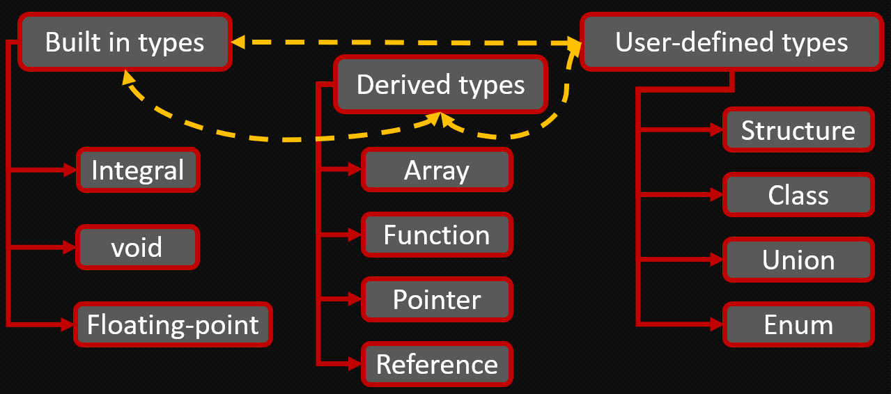
Representing types
1
2
const int*
P
C
i
\0
Notes:
How do you even represent a type? There are a couple of ways.
1st – you encode the type. Look at the example (go through it)
2nd – build a hierarchy of classes which will correspond to the type system

Slide 9
Encoding
Pros
Cons
Slow
Involves inefficient algorithms
Multiple passes might be needed
Overall inconvenient to work with
Better locality (cache-friendly)
???
Notes:
Let's look at pros and cons of encoding. Of course, it is more potentially cache-friendly than a bunch of objects somewhere in memory, but that's pretty much it.
On the other hand, it is extremely inefficient because you have to handle lots of strings
Also, newbies get confused with it, and it is loaded with dirty hacks

Slide 10
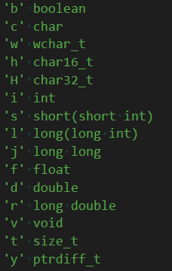
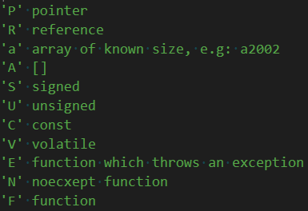
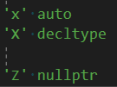
One tiny issue
Notes:
There's one issue with encoding – we're running out of letters

Slide 11
Another tiny issue
int *p;
class MyClass { int x; };
int main(int argc, const char **argv);
std::array<MyClass, 10> arr;
Pi
Ђ\aMyClass
FiPPCc-i
QЂ\x2Ђ\x3stdTЂ\x5arrayЂ\x15Ђ\aMyClass*12345678
Notes:
Another one – just look at these. Make funny comments here

Slide 12
Huge problems
auto someType = // get type info about some entity
if (!someType.IsFunction())
{
return false;
}
// a very computation-heavy piece of code goes here
A quick "bug-out" check
Or is it?
Notes:
Now, to serious issues. Look at this example. This code performs a quick check before trying to run some complex logic. Looks good, right? Or does it?

Slide 13
Huge problems
bool TypeInfo::IsFunction()
{
Normalize();
auto e = m_env;
auto ptr = SkipCvde(m_encode, e);
return ptr && *ptr == 'F';
}
How many loops?
Notes:
Here's what IsFunction does. How many loops do you see in this picture? No, zero is a wrong answer.
We need to figure out what those functions do. SkipCvde is one loop. It just drops qualifiers. What about Normalize?

Slide 14
Let's estimate
TypeInfo::Normalize
Check cv-qualifiers
Traverse string, set internal fields
Resolve typedefs
Go and look in the symbol table
Figure out template arguments
Voodoo magic here
Extract class info
Go and look in the symbol table
Notes:
It does a lot of things. It checks cv. What I mean by "checks" will be evident later. Also, it resolves typedefs, tries to figure out template instantiations, and extracts information about associated classes (we have a special object for that). Cv check just walks the string and stores info in internal fields for faster access. Others are more complex. Typedefs are in the symbol table, so they need to be extracted, templates are dark magic, and classes are in the symbol table too.

Slide 15
Let's estimate
TypeInfo::Normalize
Check cv-qualifiers
Loop
Traverse string, set internal fields
Recursion
Resolve typedefs
???
Go and look in the symbol table
Figure out template arguments
Recursion
Voodoo magic here
Extract class info
Recursion
Go and look in the symbol table
Notes:
What does this mean? Cv check (worst case) is a loop. Typedefs potentially mean recursion, because there can be chains of them. Template args are tricky, but they often mean recursion too, because we may need to resolve typedefs. Classes also have this problem. Recursion depth is not huge, but it has a significant overhead.

Slide 16
So?
Checking what something is
MUST be O(1).
It's that simple
Notes:
So what do we have in the end? We cache resolved types associated with specific entities, but even then, it becomes detrimental, long-term. Having said that, why do we have to pay the cost anyway when almost everything, if done properly, must run, more or less, in constant time?

Slide 17

The better system
Notes:
So, we had this brilliant idea. What if we build a class hierarchy for types? This is so fresh, innit?

Slide 18

But first...
Notes:
First, huge thanks to all the people who made clang. It was type system that heavily inspired ours.

Slide 19
Structure
Type
Id
Canonical type
Builtin
Pointer
Reference
Function
Class
Alias
etc.
Derived classes
Specific info
Notes:
Here's how types are made. We have the base class, which has an id. It also contains something called canonical type (more later). Derived classes contain specific info

Slide 20
Id
auto someType = // get type info about some entity
if (!someType.IsA(TypeId::Function))
{
return false;
}
// a very computation-heavy piece of code goes here
A quick "bug-out" check
Or is it?
Notes:
Here's why the Id is very important. Let's check an example. The same we looked at before. Does this work as a quick bug-out check now?

Slide 21
Id
template <typename TypeId, typename ...TypeIds>
bool IsA(TypeId id, TypeIds ...ids) const noexcept
{
return ((What() == id) || ... || (What() == ids));
}
{
return m_id; // enum class Id : uint8_t
}
Notes:
In fact, it does. The IsA method is nice and simple like this. What() just gives you the value of one internal field. It's all more complex than that, but it will do for now

Slide 22
Canonical type
int a = 42;
Type: Builtin, int
Canonical: Builtin, int
typedef int MyInt;
MyInt a = 42;
Type: Alias, typedef
Canonical: Builtin, int
Notes:
Now what is canonical type? It is the base type associated with an entity, meaning that it drops any type aliases. Play a game with the type of 'a'

Slide 23
Canonical type
typedef int MyInt;
using TheUltimateIntOfDoom = MyInt;
TheUltimateIntOfDoom a = 42;
Type: Alias, using
Canonical: Builtin, int
Source: Alias, typedef
Notes:
There's one issue with aliases. They can be chained. In this case, we might lose information. Play the 'a' game again. As you can see, type is a using alias, canonical is int, but what if we need to know whether we have an alias of alias? For this, we have source

Slide 24
Enum
Alias
CastOperator
Class
Builtin
ClassMember
Function
Ctor
Complex
Dtor
Operator
MemberPointer
Auto
AssignOp
Type
Pointer
Decltype
Array
Template
Reference
Adjusted
TemplateVar
TemplateParam
Deduced
SubstPack
TemplateSpec
TemplateInstance
Decayed
SubstTemplateArg
Notes:
Here's our current class hierarchy. Talk about every type here.

Slide 25

Qualifiers
const volatile int tricky = 42;
?
Type: ConstVolatileBuiltin, int
Notes:
I haven't said anything about qualifiers, have I? They can be applied almost to any type, and you just have to take them into consideration. What to do with it? It's a very good question, and a scary one.
Do we really have to make a special type for each qualifier combination? Or maybe, store them inside the type somehow? It would be one big mess, really

Slide 26
Qualifiers
QualType
0x00
Address in memory
C
V
R
5 bits
Notes:
Well, clang to the rescue. Enter QualType. This was the cool idea I shamelessly borrowed from them. What is it?
I can answer this question by using pointers. A pointer contains an address in memory. Typically, 8 bytes. But if you look at it, you'll see that the MSB is always 0. This is because it is reserved by the OS. You've got only 7 bytes in user space. Such a waste, isn't it?
But it is good for us. Let's use it.

Slide 27
Quality pointer
QualType
Type qualifiers:
const
volatile
restrict
Pointer to the base Type class
Notes:
So, QT is basically a pointer with some extras. It stores type qualifiers along with a regular pointer to the base class of all types. All fits in sizeof(ptr) bytes

Slide 28
How it fits together
Type System
Factory
Cache
Traits
Hasher
Notes:
Type system has a factory which creates types. Why factory? Because it also has a type cache (to avoid making copies of the same type). It uses a hasher which allows us to just extract a type which already exists. It also has traits

Slide 29

Profit
Types are immutable
There's only one copy of each unique type
To compare types, you just compare hash values
Type "pointers" (QualType) are not nullable

Slide 30
Base Type class
public:
Id What() const noexcept;
bool IsUnresolved() const noexcept;
bool IsAnyAutoType() const noexcept;
QualType GetCanonical() const noexcept;
QualType Wrap(TypeQualifiers quals = {}) const noexcept;
size_type Sizeof() const noexcept;
size_type Alignof() const noexcept;
private:
QualType m_canonical;
hash_type m_hash = 0;
Id m_id;
Notes:
Type interface bit by bit. Just talk as it appears

Slide 31
PointerType
public:
QualType Dereference() const noexcept;
template <typename TypeId, typename ...TypeIds>
bool IsAnyOf(TypeId id, TypeIds... ids) const noexcept
{
return m_pointee->GetCanonical().IsA(id, ids...);
}
private:
QualType m_pointee;
Notes:
What's extra in derived classes? Well, not much. Here's what a pointer looks like

Slide 32
Polymorphism?
bool IsThisAnIntPointer(QualType qt)
{
if (auto t = qt.TryGetAs<PointerType>())
{
auto p = t->Dereference()
.TryGetAs<BuiltinType>();
return p && p->IsAnyInt();
}
return false;
}
Notes:
We decided to ditch virtual functions. So we've got a class hierarchy without polymorphism. Now we have to use static_cast everywhere, right?
Here's a hypothetical function which checks that we have a pointer to some integer type. Discuss every line as it appears

Slide 33
template <typename T>
auto TryGetAs() const noexcept
{
return To<T>(GetTypePtr());
}
template <typename T>
auto To(Type* src) noexcept -> std::remove_const_t<T>*
{
return IsA(src, type_id_from_type_v<T>)
? static_cast<std::remove_const_t<T>*>(src)
: nullptr;
}
#define MAKE_TYPE_TRAITS(t, id) \
template <> struct type_id_from_type<t> \
{ \
static constexpr TypeId value = id; \
}; \
template <> struct type_from_type_id<id> \
{ \
using type = t; \
};
Notes:
Now, what is this dynamic_casty thing we have here? Let's take a look. Talk about To, apologize for the macro :)

Slide 34
Another way
bool IsThisAnIntPointer(QualType qt)
{
if (!Traits::IsPointer(qt))
return false;
auto t = Traits::RemovePointer(qt)
.TryGetAs<BuiltinType>();
return t && t->IsAnyInt();
}
Notes:
Another way it could have been written is this

Slide 35
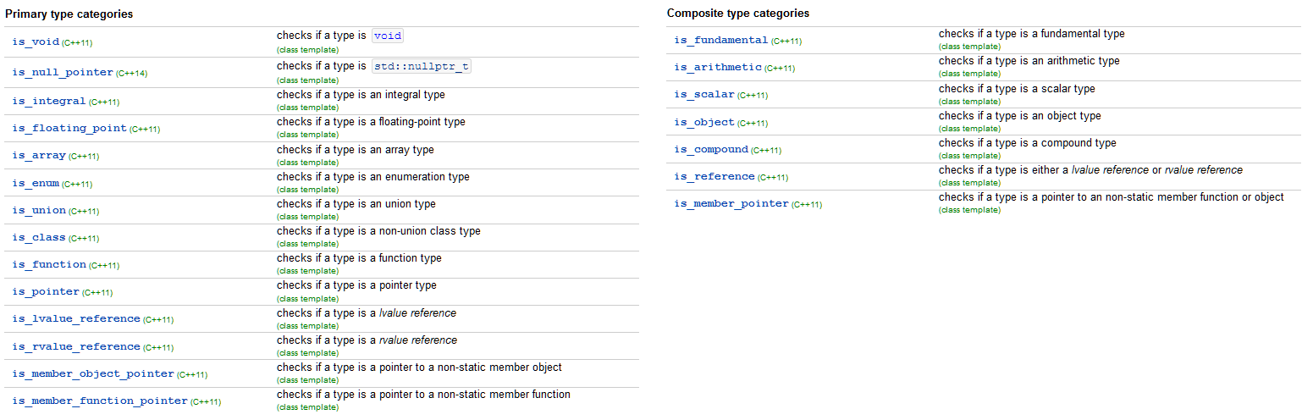
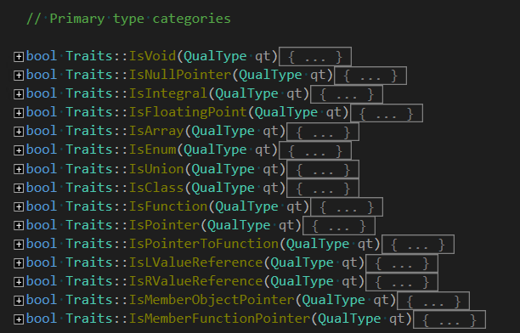
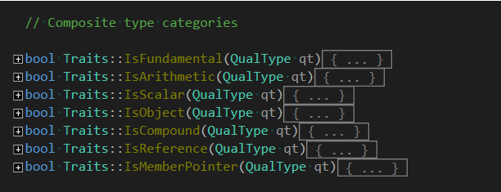
Traits
Notes:
Speaking of traits. Std has a number of them, and we have most of them too. Just to name a couple of categories, here are primary and composite ones.

Slide 36
Traits
QualType Traits::Decay(QualType qt)
{
auto type = RemoveCVRef(qt);
if (IsFunction(type))
return AddPointer(type);
if (auto arrT = type.TryGetAs<TypeId::Array>())
return AddPointer(arrT->GetElementType());
return type;
}
Notes:
Let's check how decay works, for instance. Discuss things as they appear

Slide 37
How it fits together
Diagnostic rule
auto type = decl->GetType();
if(Traits::/*....*/)
{
//....
}
int* p = nullptr;
AST (declaration)
Parser
auto pointee = TypeSystem::GetBuiltin(BuiltinId::Int).Wrap();
auto result = Traits::AddPointer(pointee);
Notes:
Here's how it fits together. Let's say we've got something like an int ptr declaration. It gets to the parser. The parser builds an AST node for it. It also determines the type. Here, it's easy to do because we know it's int. The type is them assigned to the tree node itself. Of course, more goes on in the background, but this is a simplified scheme. Eventually, a diag gets called on this node. It then proceeds to perform checks and decides whether it should issue a warning. Working with types is really easy this way because the trait system mimics that from std, and it looks familiar.

Slide 38

Summary
Notes:
There you have it. I could talk for hours on this topic. Hopefully, I managed to pack it enough and still have it make sense. The old system was crap, the new one is much more convenient and robust. Once again, I would like to thank those who have come up with ideas I implemented in our code. Without them, it would've been much harder to do.

Slide 39

Inside a static analyser:
type system
Yuri Minaev
minaev@viva64.com

